Slide 1

From despair to hope:
a sentiment analysis of queer and trans Asian Pacific Islander (QTAPI) blogs
Binh Hoang

Slide 2


Introduction
General QTAPI blogs – anyone in the community can contribute.
Crowdsourced ideas: in the end, did sentiment analysis to test my prior assumptions.

Slide 3

Data
34
+
=
376 blog
posts
(~196k words)
342

Slide 4
Methodology
Web Scraping
Data Storage
Preprocessing+ Analysis
Visualizations
BeautifulSoup
MongoDB
NLTK
Spacy
Vader
Scikit-learn
Seaborn
Plotly

Slide 5
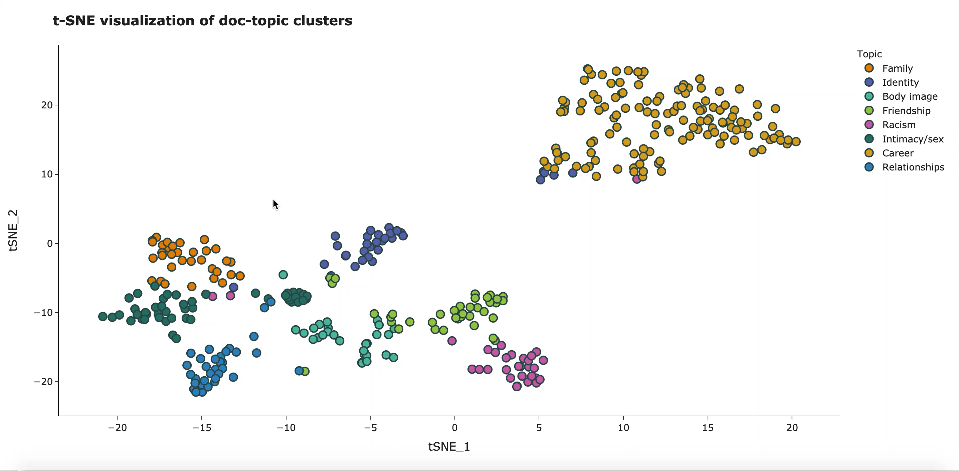

Slide 6
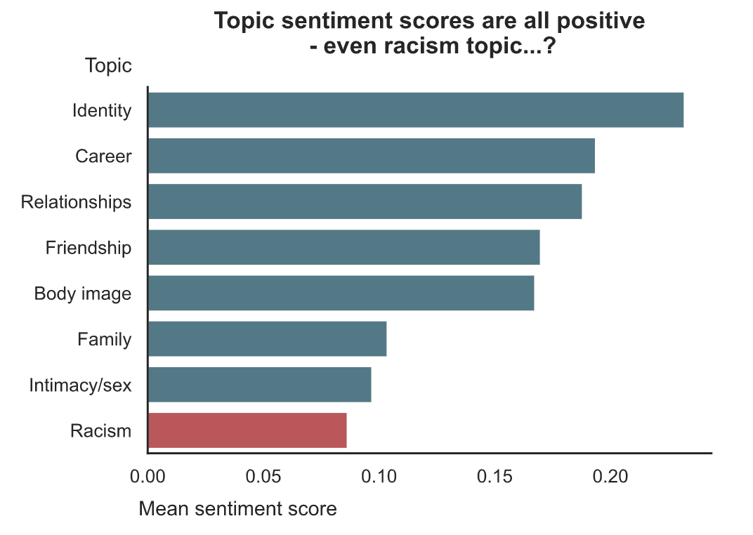

Topic sentiment using VADER
Why are these scores all positive? 😮
VADER
Score range: -1 to 1
😄 Positive sentiment: >=0.05
😐 Neutral sentiment: -0.05 – 0.05
😭 Negative sentiment: <= -0.05
Methodology note
Sentiment scores calculated for each sentence and then averaged per blog post.

Slide 7
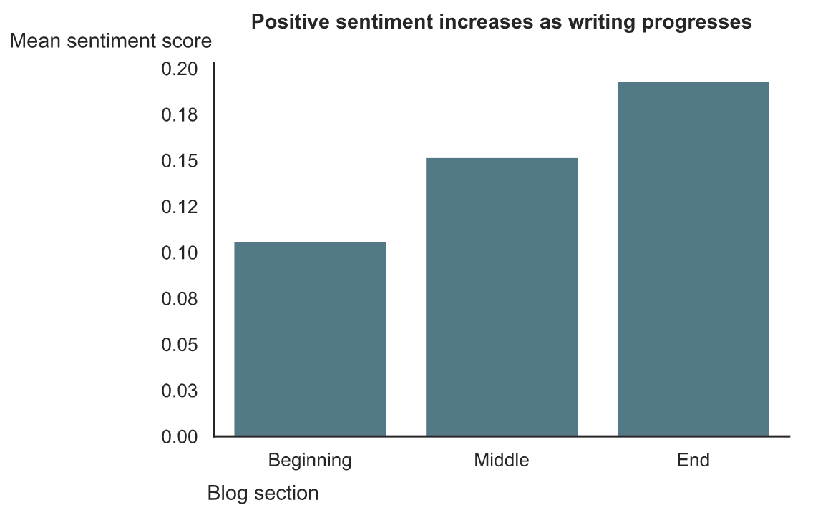
Sectional sentiment analysis

Slide 8
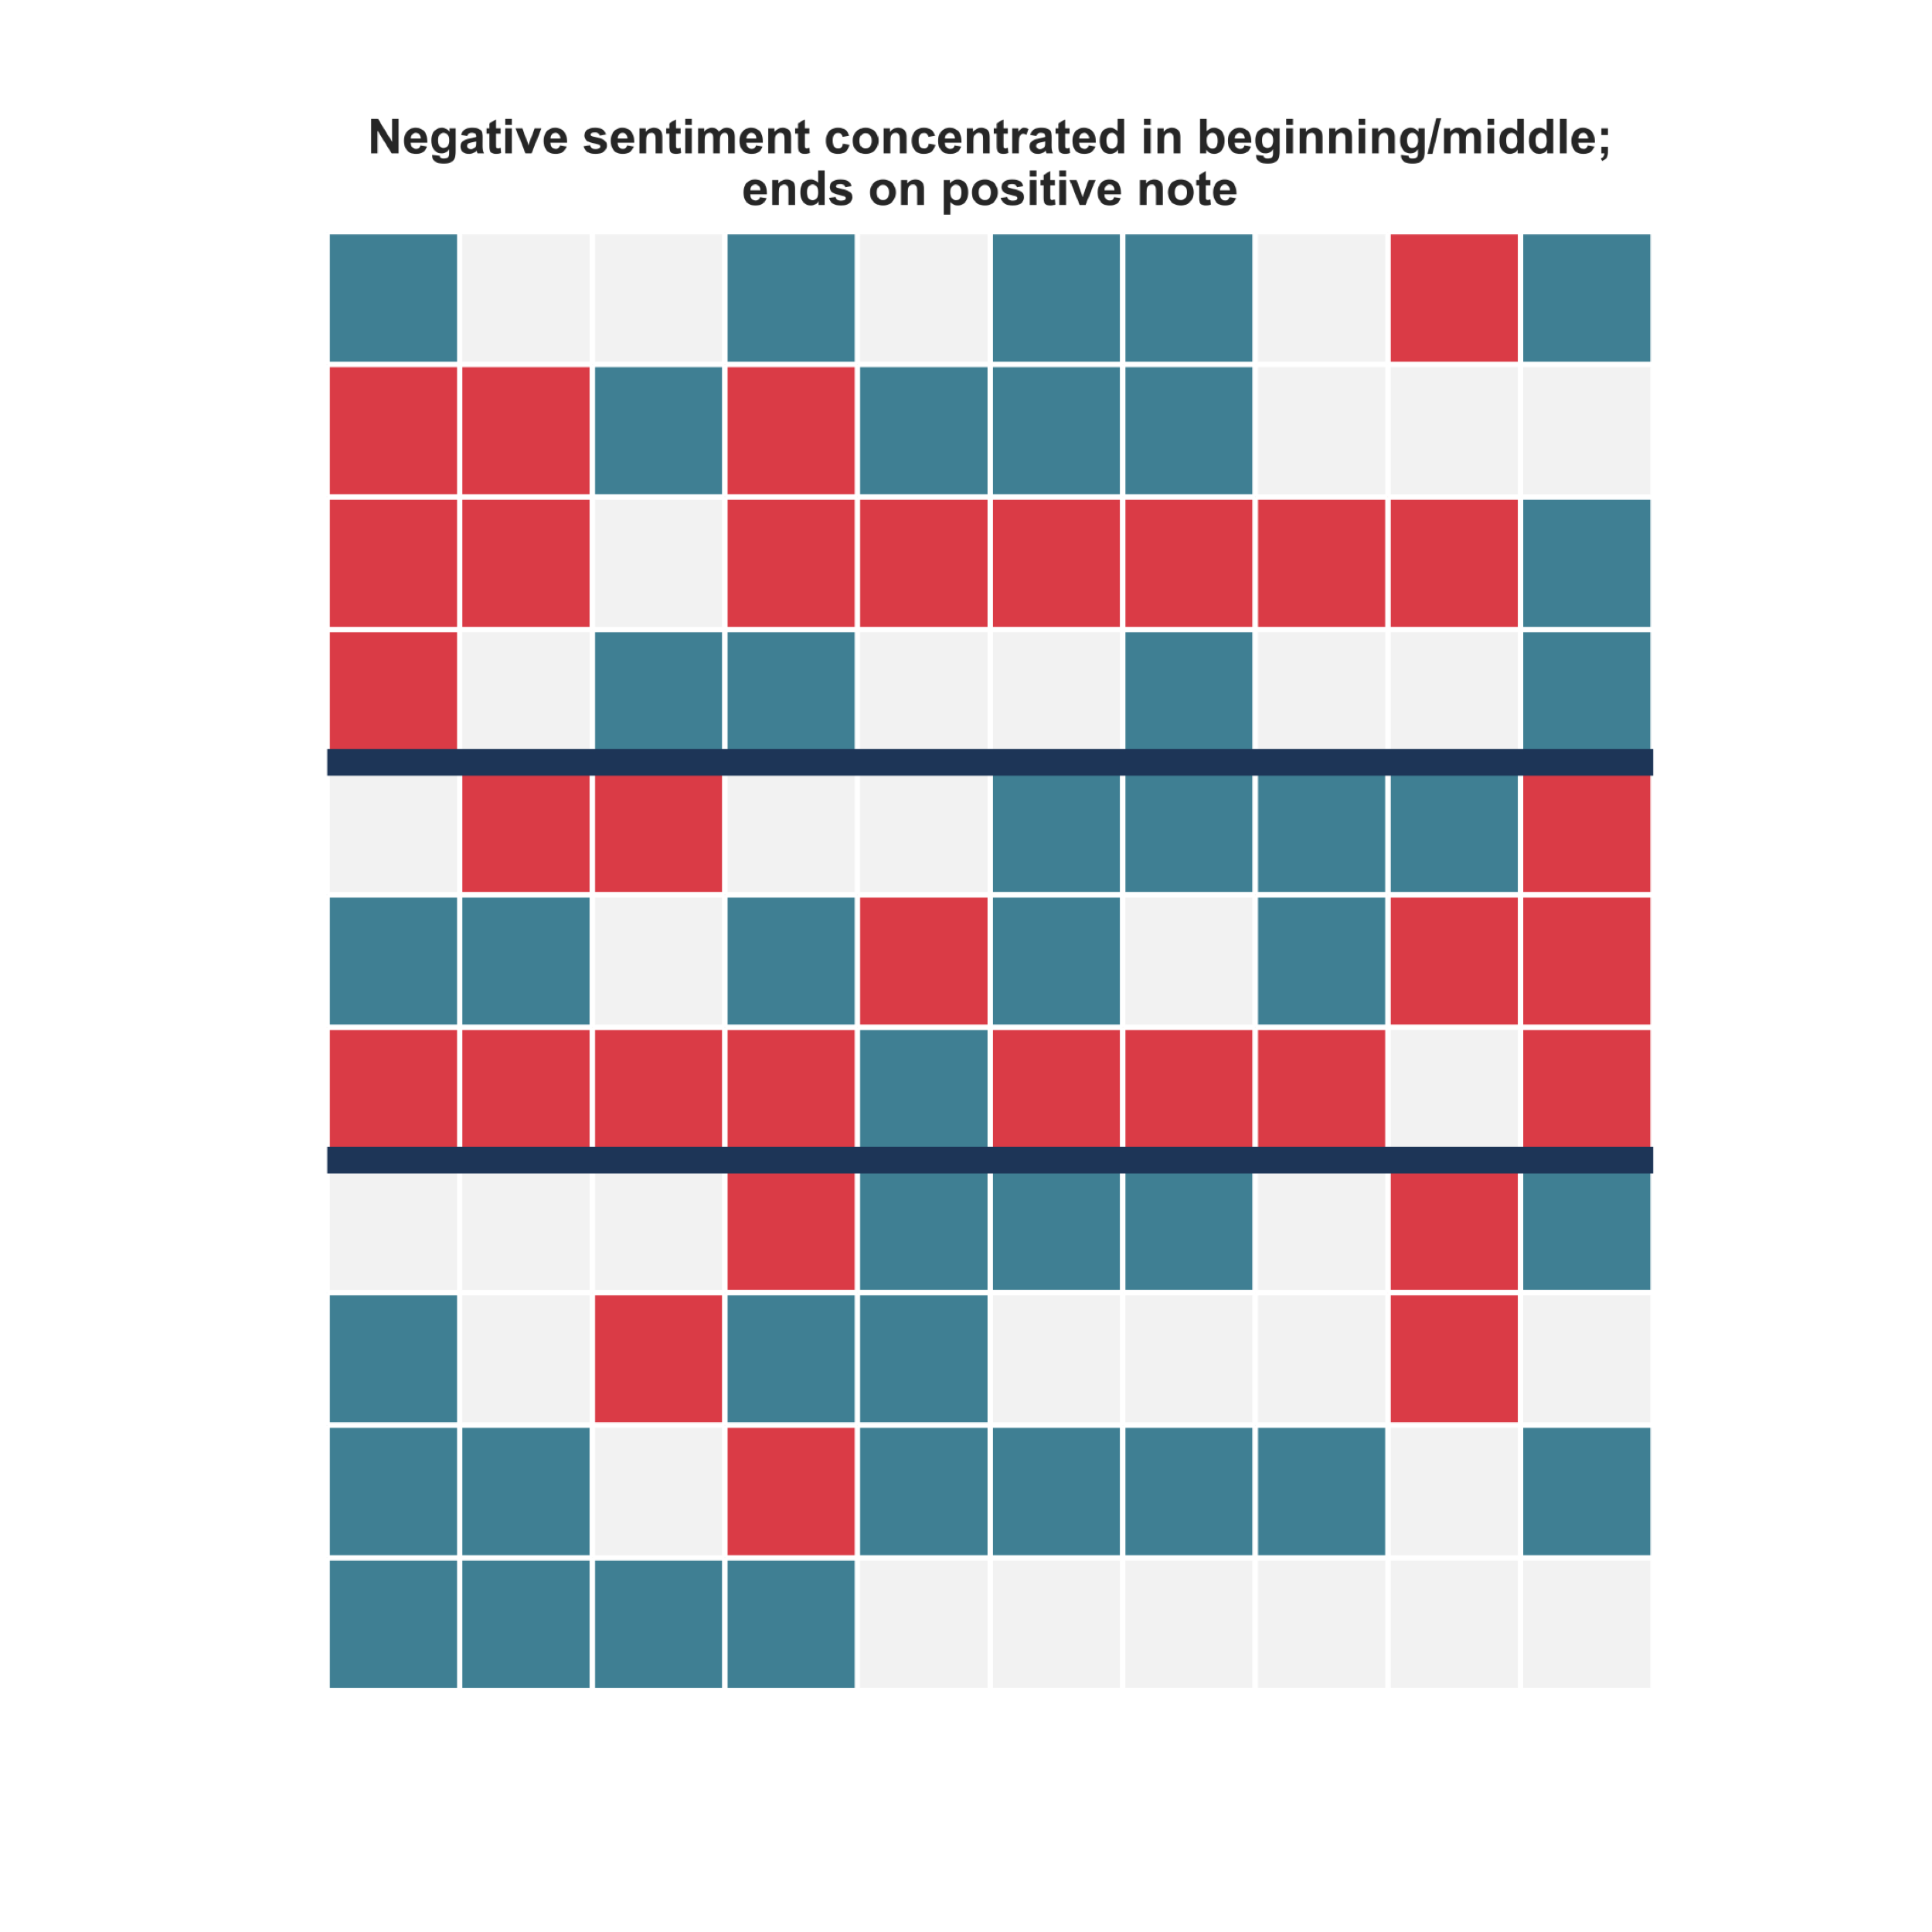
Sentiment map: gaysian diary entry #5
Sentence order: →↓
Instead, I found my first heartbreaks, shame, meaningless hookups and fear of catching some unwanted bugs.
Beginning
Score = -0.01
😄
😐
😭
I was hurt, jaded and cynical,
and I hated gay guys.
Middle
Score = -0.05
…I hope the next generation of gaysians coming to terms with their identities will have different, more positive and supportive “firsts”.
End
Score = 0.18

Slide 9


Conclusion
I think the upward trend in sentiment says something about the queer and trans API community (and possibly about humans in general), that despite the hardships that a marginalized community faces, many hold hope for a better tomorrow.
Beginning
End

Slide 10
Future work
Scale up to include other social media posts: Twitter, Facebook, Reddit
Compare and contrast blogs of QTAPI community with blogs of other queer and trans communities

Slide 11

Thank you!

Slide 12
References
Hutto, C.J. & Gilbert, E.E. (2014). VADER: A Parsimonious Rule-based Model for Sentiment Analysis of Social Media Text. Eighth International Conference on Weblogs and Social Media (ICWSM-14). Ann Arbor, MI, June 2014.

Slide 13
Methodology notes
The beginning/middle/end mean sentiment scores were calculated for blog posts with a word count greater than 500 words since only longer blog posts would have a meaningful division between beginning, middle, and end.

Slide 14
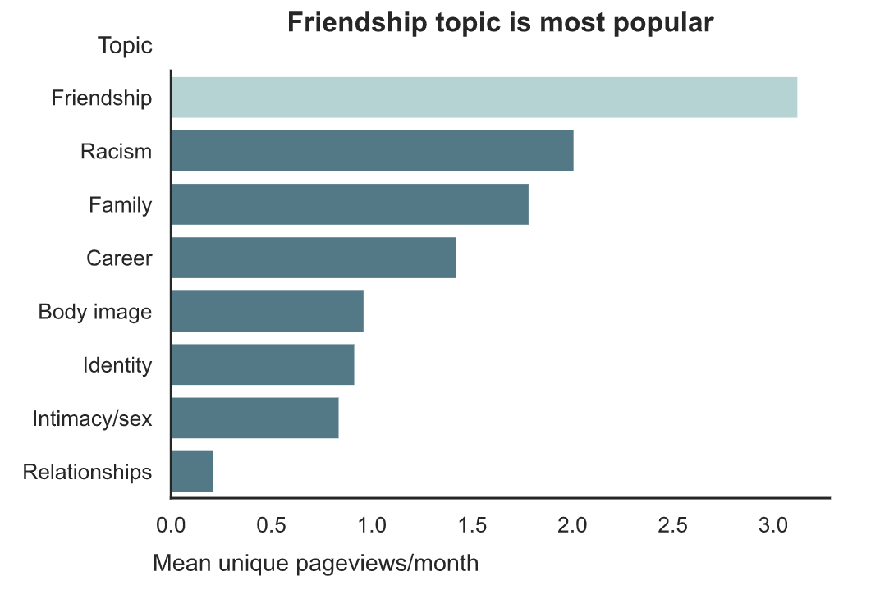
Topic popularity

